Slide 1


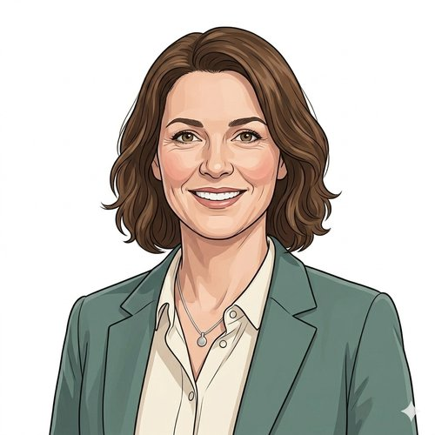
HEARTS AND MINDS · A COMMISSIONER'S STORY THROUGH THE OPERATING MODEL
Sarah.
Sarah signs once. Not once a quarter.
Sarah commissions sexual health for her Local Authority. UKHSA data shows an HIV detection gap concentrated in the wards her service struggles hardest to reach. She has the budget. She does not have the headcount to design a bespoke procurement around home self-testing for every supplier on the market. This is the story of one commissioner, one platform, one signature, and an operating model that does the procurement work for her.
Sarah
LA sexual health commissioner · HomeTest HIV
Hearts and Minds · Sarah's journey · HomeTest operating model · September 2026
Commercial positions are agreed in principle and remain subject to the live procurement.
Notes:
Sarah's story, told through the operating model. Open on the person, not the pathway.

Slide 2
SARAH'S JOURNEY AT A GLANCE
Easy buying. So the buying gets out of the way and the population outcome stays in focus.
1
→
2
→
3
→
4
→
5
→
6
The brief · a population
One front door · the framework opens
Fit for HER cohort · the questions standard answers don't solve
One call-off · signing
Live operation · kits out
The board paper · what the members see
a gap, twelve months to move
not procuring
results back
The framework opens
What the members see
The questions standard answers don't solve
THE NORTH STAR
WHY ONE PLATFORM MATTERS TO HER
Easy buying. So the buying gets out of the way and the population outcome stays in focus.
One framework. One signature. One platform she can come back to as her cohorts and questions change.
Commissioners do not buy home testing for the joy of running procurements. They buy it to close a detection gap, reduce late diagnoses, or get more out of a stretched service. The operating model exists so the buying stops being the work. Easy buying is the North Star, not because procurement should be lazy, but because effort spent on procurement is effort not spent on population health.
Sarah
A bespoke HIV-only procurement would buy a single deployment. The next cohort (chlamydia, syphilis, the next configuration the platform admits) would mean another procurement, another assurance set, another contract, another integration. The framework means Sarah signs once, the same NHS Login carries her cohorts, the same MI feed answers the same questions, and the next configuration is an extension, not a new programme. The integration was done before she walked in.
LA sexual health commissioner · HomeTest HIV
Hearts and Minds · Sarah's journey · HomeTest operating model · September 2026
Commercial positions are agreed in principle and remain subject to the live procurement.
2

Slide 3

SARAH'S JOURNEY · STAGE 1 OF 6
01
The brief · a population
a gap, twelve months to move
Sarah has an HIV detection gap she can see on the UKHSA dashboard. The late diagnoses are concentrated in MSM under-25s and the wards her clinics struggle hardest to reach. The Health and Wellbeing Board wants outcomes. She has twelve months and the LA sexual health budget. She does not have the headcount to bespoke a procurement around every supplier on the market.
“I can see the gap on the dashboard. I've got money on the table and the Board wants to see movement inside a year. What I don't have is the headcount to bespoke a procurement for every supplier.” Sarah
WHAT THE MODEL IS DOING UNDERNEATH
THE OLD WAY
UKHSA late-diagnosis data showing the cohort concentrated in specific wards. A Health and Wellbeing Board paper asking what digital does for the gap. The LA sexual health budget. An existing sexual health service contract with the local provider. The clinical case is settled: home self-testing for HIV removes the clinic-visit barrier that keeps the late-diagnosed cohort away. What's in front of her is procurement, integration with the existing service, and reach into the wards that don't engage.
A bespoke procurement against the LA's contract regulations. Six to nine months. Clinical safety assurance per supplier. IG assessment per supplier. Service-contract amendment to carry the new pathway. Twelve to fifteen months from Board paper to first kit, on a good run. The last new pathway she stood up before the framework existed took twenty-two months. That is a year her late-diagnosed patients did not have.
WHO SARAH'S CARE TEAM SEES Her sexual health service provider lead. Her LA Clinical Safety Officer. Her IG lead. The public-health intelligence team who built the cohort analysis. Procurement, not yet engaged because the route is not yet chosen.
Hearts and Minds · Sarah's journey · HomeTest operating model · September 2026
Commercial positions are agreed in principle and remain subject to the live procurement.
3
Notes:
Stage 1: The brief · a population. UKHSA late-diagnosis data showing the cohort concentrated in specific wards. A Health and Wellbeing Board paper asking what digital does for the gap. The LA sexual health budget. An existing sexual health service contract with the local provider. The clinical case is settled: home self-testing for HIV removes the clinic-visit barrier that keeps the late-diagnosed cohort away. What's in front of her is procurement, integration with the existing service, and reach into the wards that don't engage.

Slide 4

SARAH'S JOURNEY · STAGE 2 OF 6
02
One front door · the framework opens
The framework opens
She opens the framework. The HomeTest platform is admitted. The HIV configuration is live. Suppliers are listed against published call-off terms. Templates ready. National pricing visible. No procurement to design from scratch.
“I expected to be writing a spec. I'm looking at suppliers I can already call off. The framework did the heavy lifting before I logged in.” Sarah
WHAT THE MODEL IS DOING UNDERNEATH
THE OLD WAY
The framework page. HIV self-test suppliers admitted to the HomeTest platform. Standard call-off terms. DSA, DPIA, privacy notice and clinical safety case starter templates pre-built. NHS Login carries the cohort. Targeting and reach capabilities exposed via UKHSA data overlays and NHSE social channels. The route is published; she just has to choose to take it.
A clean-sheet procurement compliant with the LA's contract regulations. Spec writing. Supplier engagement. Two or three rounds of clarifications. A standstill period. Bespoke clinical safety case from a blank page. Bespoke IG. Bespoke MI. Three months gone before the first contract draft.
WHO SARAH'S CARE TEAM SEES The platform's commissioner-engagement contact for the configuration. Her LA procurement lead, sense-checking the call-off route. Her sexual health service provider lead, sense-checking how the pathway plugs into the existing service.
Hearts and Minds · Sarah's journey · HomeTest operating model · September 2026
Commercial positions are agreed in principle and remain subject to the live procurement.
4
Notes:
Stage 2: One front door · the framework opens. The framework page. HIV self-test suppliers admitted to the HomeTest platform. Standard call-off terms. DSA, DPIA, privacy notice and clinical safety case starter templates pre-built. NHS Login carries the cohort. Targeting and reach capabilities exposed via UKHSA data overlays and NHSE social channels. The route is published; she just has to choose to take it.

Slide 5
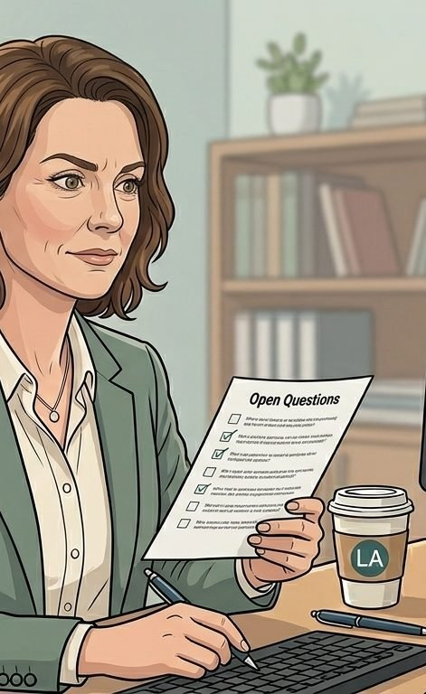
SARAH'S JOURNEY · STAGE 3 OF 6
03
Fit for HER cohort · the questions standard answers don't solve
The questions standard answers don't solve
Standard answers don't help her if her late-diagnosed patients are exactly the ones standard provision misses. Unsafe-address households. Low digital literacy. Reach into the wards her clinics don't see. She runs her open questions against the framework, expecting friction.
“Standard answers don't help me if my late-diagnosed patients are exactly the ones standard provision misses. I need to know how this works for the people I'm trying to reach.” Sarah
WHAT THE MODEL IS DOING UNDERNEATH
THE OLD WAY
Her open questions list against the framework's published outputs. The unsafe-address pathway: how kit goes to a patient whose home address is not a safe delivery point. The low-digital-literacy path: an alternative entry route for patients who can't engage with an app-led journey. The ward-level outreach overlay: how UKHSA data and NHSE social channels reach the cohorts her clinic doesn't see. The framework either answers these or it doesn't. The platform either has the capability or it doesn't. She finds out before signing.
Six rounds of meetings with each supplier to discover what they actually do for her cohort. Bespoke service design negotiated supplier by supplier. Pilot phase running into year two. Or, in the worst case, skip the question entirely and assume what is on offer is fine. The pattern from her last new pathway: assumed it would work for everyone, found out at month nine that the cohort she was targeting hadn't engaged.
WHO SARAH'S CARE TEAM SEES Her public-health intelligence lead on the cohort. Her sexual health service's outreach lead. The platform's engagement contact on unsafe-address policy and the alternative entry route. Her safeguarding officer.
Hearts and Minds · Sarah's journey · HomeTest operating model · September 2026
Commercial positions are agreed in principle and remain subject to the live procurement.
5
Notes:
Stage 3: Fit for HER cohort · the questions standard answers don't solve. Her open questions list against the framework's published outputs. The unsafe-address pathway: how kit goes to a patient whose home address is not a safe delivery point. The low-digital-literacy path: an alternative entry route for patients who can't engage with an app-led journey. The ward-level outreach overlay: how UKHSA data and NHSE social channels reach the cohorts her clinic doesn't see. The framework either answers these or it doesn't. The platform either has the capability or it doesn't. She finds out before signing.

Slide 6

SARAH'S JOURNEY · STAGE 4 OF 6
04
One call-off · signing
not procuring
The call-off goes in. Six weeks from brief to live, not eighteen months. The LA's sexual health service contract carries the home-testing pathway as an extension. NHS Login carries the cohort. Payment via published call-off terms. The procurement scar she carried in is not the procurement she ran.
“I've signed call-offs that took twenty minutes. The eighteen months I didn't spend negotiating is the eighteen months my patients didn't wait.” Sarah
WHAT THE MODEL IS DOING UNDERNEATH
THE OLD WAY
The call-off itself. The supplier admitted to the platform under the framework. The local sexual health service contract amended to carry the new pathway as an extension. DSA executed against the framework's template. Clinical safety case approved by the LA's CSO using the framework's starter case as the spine. First batch of kits ordered. Outbound communications drafted for the wards the public-health team flagged. Every step has a published template. Nothing is being designed in the moment.
A multi-year bilateral contract with each supplier. Bespoke pricing schedule. Bespoke clinical safety case from a blank page. Bespoke IG. Bespoke MI. Each adding months to the deployment timeline. Each reducing the budget left for the actual outreach.
WHO SARAH'S CARE TEAM SEES Her LA procurement lead. Her LA CSO. Her IG lead. The sexual health service provider lead. The platform's engagement contact handling the call-off process. The supplier's account manager.
Hearts and Minds · Sarah's journey · HomeTest operating model · September 2026
Commercial positions are agreed in principle and remain subject to the live procurement.
6
Notes:
Stage 4: One call-off · signing. The call-off itself. The supplier admitted to the platform under the framework. The local sexual health service contract amended to carry the new pathway as an extension. DSA executed against the framework's template. Clinical safety case approved by the LA's CSO using the framework's starter case as the spine. First batch of kits ordered. Outbound communications drafted for the wards the public-health team flagged. Every step has a published template. Nothing is being designed in the moment.

Slide 7

SARAH'S JOURNEY · STAGE 5 OF 6
05
Live operation · kits out
results back
Quarter one live. Kits going out to the wards her public-health team targeted. Self-test results triaged through her existing sexual health service. The MI feed shows reach into the cohorts standard provision missed. The pathway just works for the patient.
“Patients don't see procurement. They see a kit in the post and a follow-up from a service they trust. The pathway just works for them.” Sarah
WHAT THE MODEL IS DOING UNDERNEATH
THE OLD WAY
The MI dashboard. Kits ordered. Kits delivered. Results returned (positive, negative, invalid). Triage decisions. Follow-up clinic bookings. Reach into the target wards versus the LA baseline. Equity reach against the LA's inequality targets. Reactive support paths for unsafe-result delivery. The numbers are visible in real time. She doesn't need to wait for the annual return.
Hand-rolled MI. Manual chasing of result returns. Manual follow-up. No view of equity reach until the annual report. The risk: finding out a year late that the cohort the LA targeted hadn't actually engaged, by which time the next year's budget had been set on the assumption it had.
WHO SARAH'S CARE TEAM SEES The sexual health service provider running the clinical pathway. The supplier running the kit logistics. The platform running the data layer. The LA outreach team running ward-level engagement. Sarah herself looking at the MI feed weekly.
Hearts and Minds · Sarah's journey · HomeTest operating model · September 2026
Commercial positions are agreed in principle and remain subject to the live procurement.
7
Notes:
Stage 5: Live operation · kits out. The MI dashboard. Kits ordered. Kits delivered. Results returned (positive, negative, invalid). Triage decisions. Follow-up clinic bookings. Reach into the target wards versus the LA baseline. Equity reach against the LA's inequality targets. Reactive support paths for unsafe-result delivery. The numbers are visible in real time. She doesn't need to wait for the annual return.

Slide 8

SARAH'S JOURNEY · STAGE 6 OF 6
06
The board paper · what the members see
What the members see
First-year outcomes. HIV detection rate up. Late-diagnosis rate down. Equity reach into the wards her clinics didn't see, verified. The board paper writes itself. The next year's ask is for the next configuration, not the next procurement.
“The Health and Wellbeing Board wanted to know whether it worked. The numbers do most of the talking. The pathway behind them is what made the numbers possible.” Sarah
WHAT THE MODEL IS DOING UNDERNEATH
THE OLD WAY
HIV detection rate against the LA baseline. Late-diagnosis rate, by ward. Equity reach into the cohorts the LA targeted. Cost per detection. Clinic capacity released back to the service for follow-up and treatment. Patient feedback. Reactive-pathway performance for unsafe-result delivery. The recommendation for year two: extend to the next configuration the platform admits. Same framework. Same call-off shape. Same MI feed.
A board paper hedged with ‘data still maturing’ and ‘next year we will have a fuller picture’. Three years before a programme of this size could be evaluated against equity targets. By which time the LA had moved on, the funding had been re-prioritised, or the member who sponsored it had left office.
WHO SARAH'S CARE TEAM SEES The Health and Wellbeing Board. The Director of Public Health. Elected members on the relevant scrutiny committee. The LA finance team setting the next year's commissioning envelope.
Hearts and Minds · Sarah's journey · HomeTest operating model · September 2026
Commercial positions are agreed in principle and remain subject to the live procurement.
8
Notes:
Stage 6: The board paper · what the members see. HIV detection rate against the LA baseline. Late-diagnosis rate, by ward. Equity reach into the cohorts the LA targeted. Cost per detection. Clinic capacity released back to the service for follow-up and treatment. Patient feedback. Reactive-pathway performance for unsafe-result delivery. The recommendation for year two: extend to the next configuration the platform admits. Same framework. Same call-off shape. Same MI feed.

Slide 9
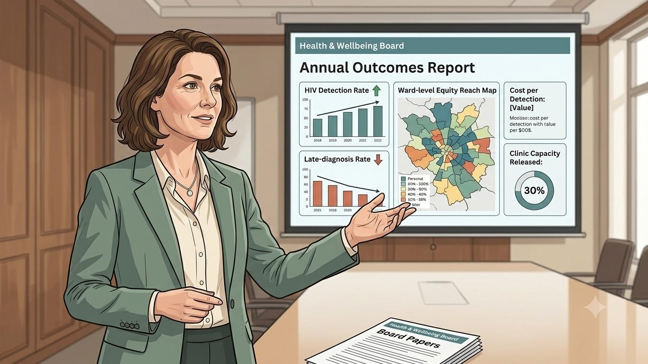
SARAH'S WIN
Detection earlier in the wards her clinics did not reach. Late diagnoses down. Equity verified.
THE MONEY IN THIS STORY
Sarah buys from the framework by call-off: a cost per activity for each completed test, against a national ceiling she can beat locally as volume grows. She pays the supplier direct from the sexual health budget she already holds; NHSE holds no budget between them and no new national pot is created. The supplier's price carries a levy of one to two percent of throughput that funds the framework, so it never appears as a line on her invoice.
The patients didn't see a procurement. They saw a kit in the post and a follow-up call from the sexual health service. The eighteen months Sarah didn't spend on the back office is the eighteen months her patients didn't spend undiagnosed. The next configuration is an extension of the same signature, not a new programme from a clean sheet.
The assurance was done once, nationally, before she ever picked up the phone, which is why buying took a signature and not a season of paperwork.
Easy buying. So the buying gets out of the way and the population outcome stays in focus.
Sarah
LA sexual health commissioner · HomeTest HIV
Hearts and Minds · Sarah's journey · HomeTest operating model · September 2026
Commercial positions are agreed in principle and remain subject to the live procurement.
9

Slide 10
Sarah
LA sexual health commissioner · HomeTest HIV
Easy buying. So the buying gets out of the way and the population outcome stays in focus.
Hearts and Minds · Sarah's journey · HomeTest operating model · September 2026
Commercial positions are agreed in principle and remain subject to the live procurement.
10

